Slide 1

HOSPITALITY DOMAIN ATLIQ GRANDS
(GROUP 3)

Slide 2
INTRODUCTION
Revenue generation is the way or manner in which a company sells itself and its products to the public to make money. It is a strategic operation that touches every part of an organization; it is not just sales or marketing. In the hospitality domain, revenue is generated through hotel room rentals, meeting space occupancy, and sales of food or beverages. Businesses face a period of growth and decline, and the hospitality industry is no exception. One thing is certain and phenomenal, the hospitality industry lives and dies by its customers. Good customer service can be a revenue generator for a hotel. Focusing on small details can mean the difference between remaining stagnant or increasing profitability. Small things add up.
This document presents the analysis of hotel data for AtliQ Grands, from May 2022 - July 2022. This will enable us to gain insights into various aspects of hotel management, including, customer ratings, occupancy rates, revenue, and bookings. This analysis was performed using Microsoft Excel ,Tableau and Power BI, a powerful data visualization and analytics tools.

Slide 3
DATA OVERVIEW
The data model in Power BI consists of five tables:
dim_date: Contains full date information about dates including day type (weekend or weekday), month, and week number (W19 — W32).
dim_hotels: Stores identity number of the hotel, property name, category it belongs to (luxury/business), and the city it’s located.
dim_rooms: Includes room id and room class.
fact_bookings: Stores information about bookings including booking dates, booking platforms, number of guests, revenue, check-in, and checkout dates.
fact_aggregrated_bookings: Includes successful bookings, hotel id, and capacity. The dimension tables (with the prefix “dim”) have a matching id in the fact tables (with the prefix “fact”). This modeling produces a one-to-many relationship.

Slide 4
KPI LIST
Total Revenue
Total Booking
Utilize capacity
Occupancy %
AVG. Rating
Cancellation Rate
Realisation %

Slide 5

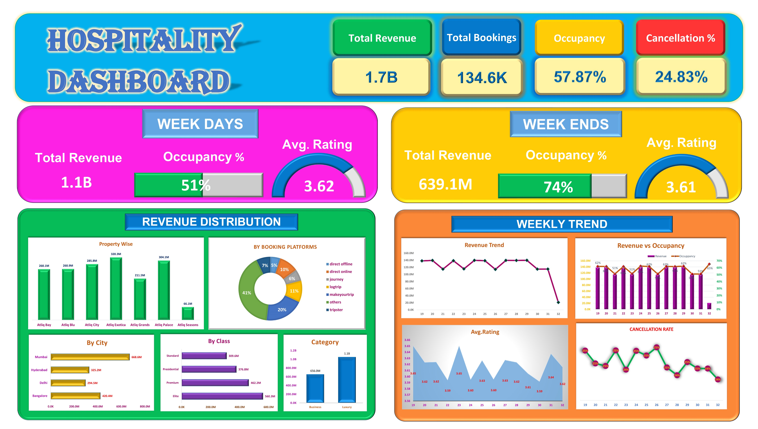
EXCEL DASHBOARD

Slide 6

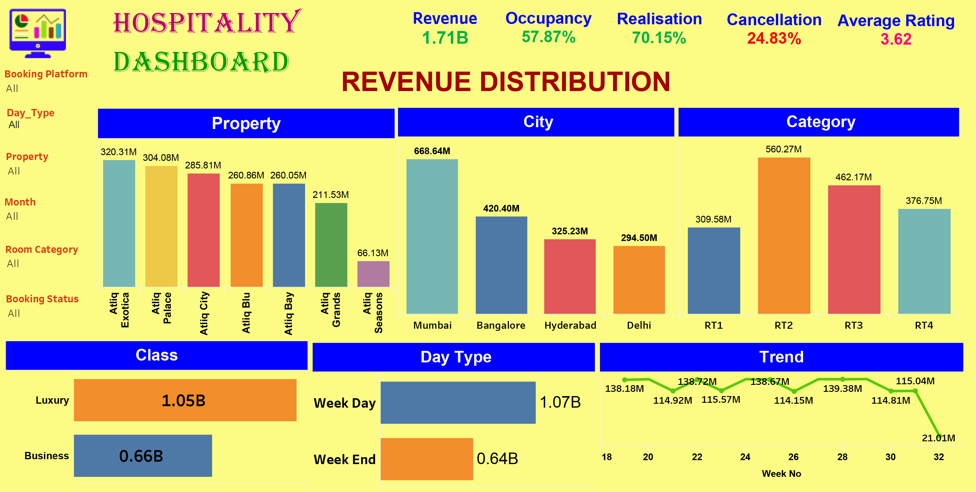
TABLEAU DASHBOARD

Slide 7
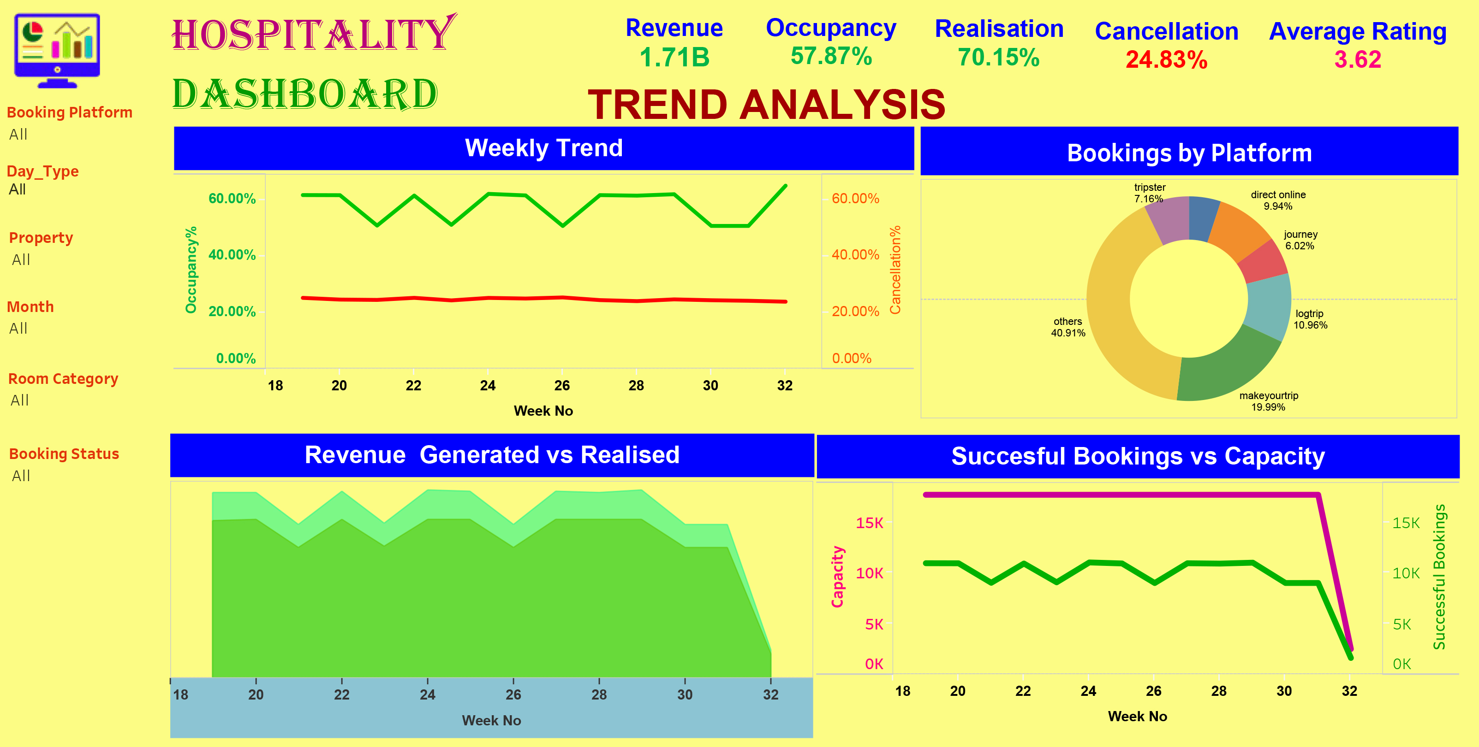
.

Slide 8

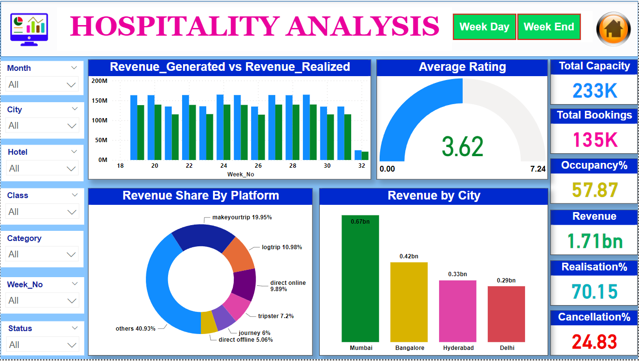
POWER BI DASHBOARD

Slide 9
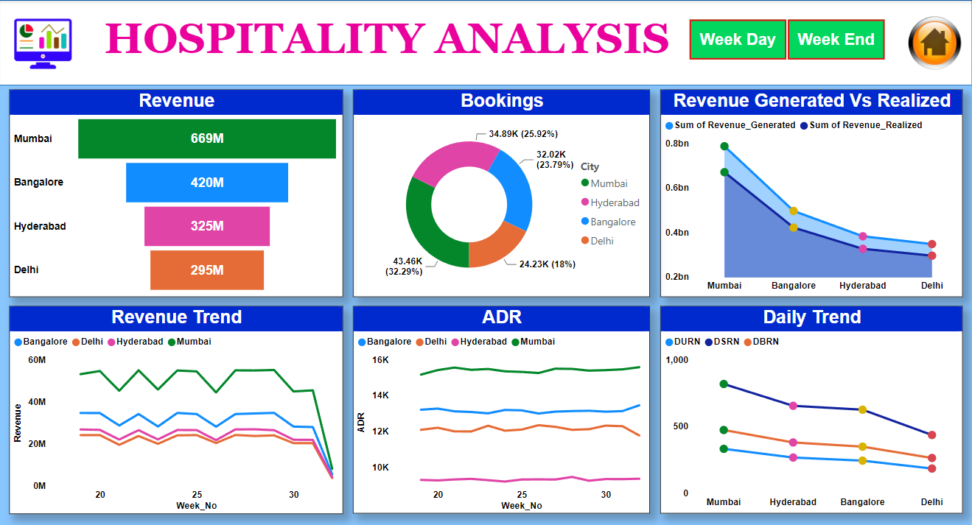
.

Slide 10
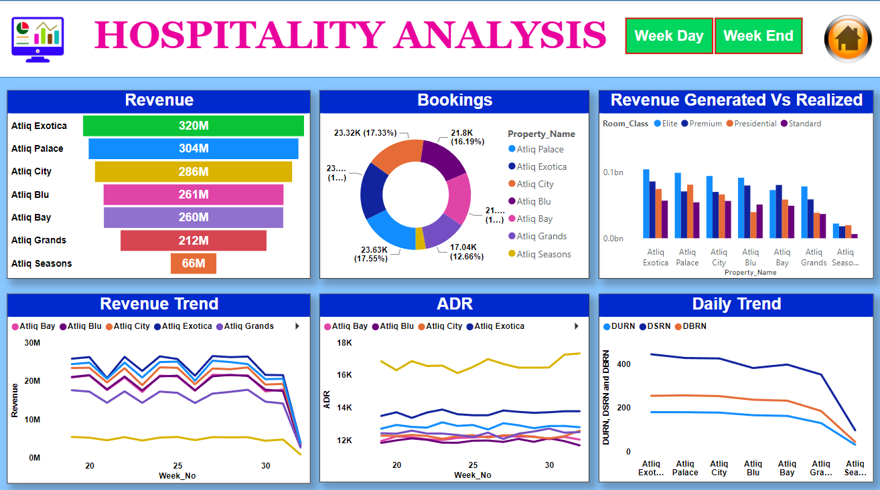
.

Slide 11
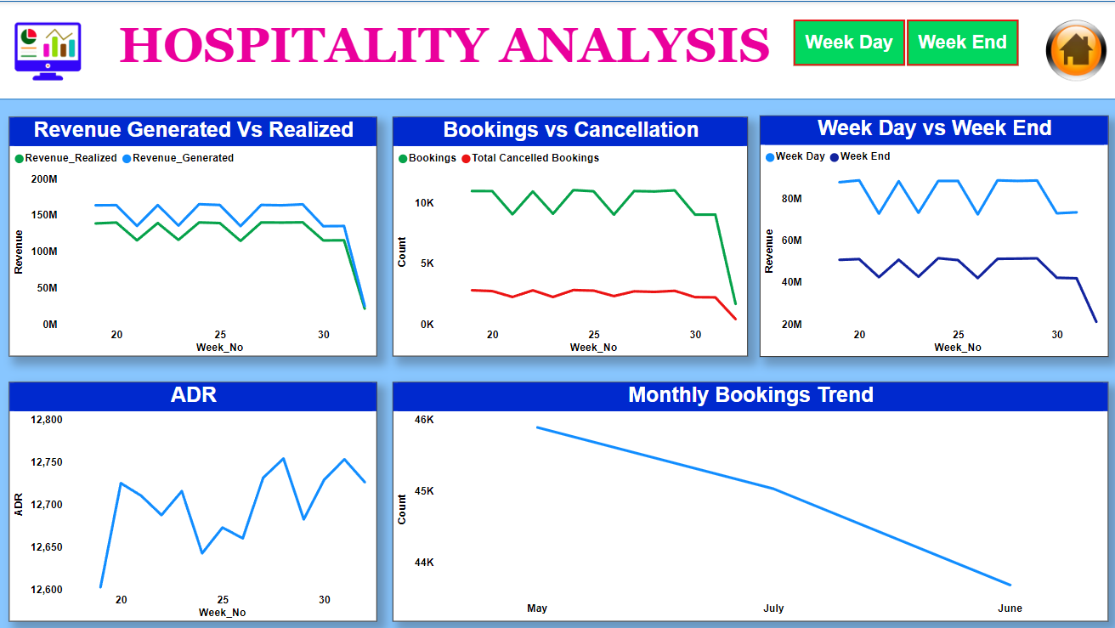
.

Slide 12
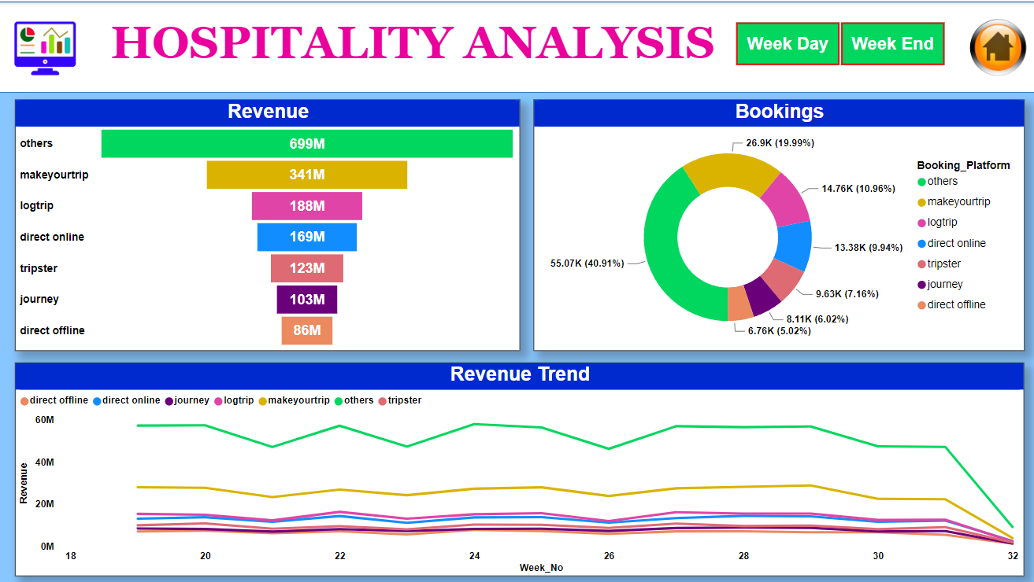
.

Slide 13
KEY FINDINGS
After analyzing the data, we were able to derive these insights:
Over the period of three months (May, June, and July), AtliQ Grands were able to generate a revenue of approximately 1.7 billion (1.69b). During this period, Revenue, ADR, occupancy, and RevPar increased from the latest previous week.
The overall average rating is 3.62. Customer satisfaction has improved over the past three months, with an average rating increase of 1.27%. Although some hotels have ratings lower than the average.
Weekends consistently exhibit higher occupancy rates than weekdays. There is no significant difference in ADR for weekdays and weekends. This shows that the hotel is using a flat pricing strategy.
Other travel platforms/channels are the primary booking source, generating 40% of total bookings and revenue. Direct offline booking contributes the least to bookings and revenue generation, with 5%.
The Average Daily(ADR) Rate is higher on direct offline (hotel premises) compared to other booking platforms.
The Luxury room category contributes the majority of revenue and bookings. Mumbai city contributes most of the revenue, followed by Bangalore, Hyderabad, and Delhi.
There is a correlation between revenue and average ratings, in that ratings with high ratings tend to generate more revenue.

Slide 14
KEY INSIGHTS
The rule of demand and supply and price elasticity is different for the travel, tourism, and hospitality industry. Therefore, the hotel should leverage dynamic pricing to increase revenue generation and increase prices for peak days and weekends.
Consider differential pricing strategies for their offline booking platforms by implementing targeted marketing campaigns/promotions to boost bookings and in turn increase revenue.
AtliQ Grands should pay more attention to customer reviews and ratings and focus on improving customer satisfaction further by addressing critical areas identified in customer reviews.
Explore opportunities to increase direct bookings through the hotel’s website to reduce dependence on other online platforms.

Slide 15
THANK YOU
.

